Slide 1


Machine Learning LAB
Week 01

Slide 2
Python Machine Learning Steps
Python Machine Learning Workflow
Loading the Dataset (Consists of Input Features (X) and Class/Output (y)
Preprocess the Dataset
Analyze the Data Set
Apply Learning Scheme OR Algorithm
Generate Model and Predict
Evaluate the Model
Understanding Nature of Problem

Slide 3
Lab Contents
Loading the Dataset
Preprocess the Dataset
Data Visualization
Exploring the Dataset
Machine Learning Workflow

Slide 4
Loading the Dataset
Many ways to Load Data in Python:
Load Data from Dataset module of Python
Save in Simple Arrays
Save in Dictionary OR Data frame in Pandas
Load data from File mostly in CSV format
Load data from Web source

Slide 5
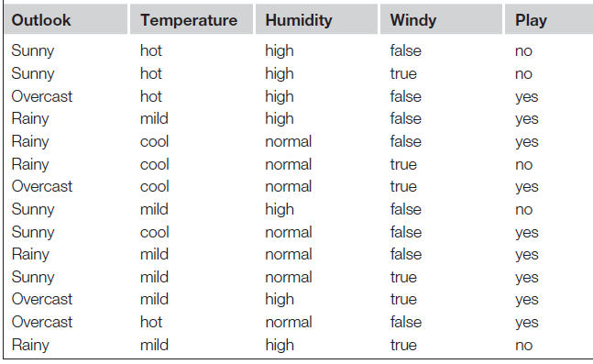
Example
(Weather Data)
Features
Instances/Examples
Input/X
Output/Y/Target
Type of Problem (R/C)

Slide 6
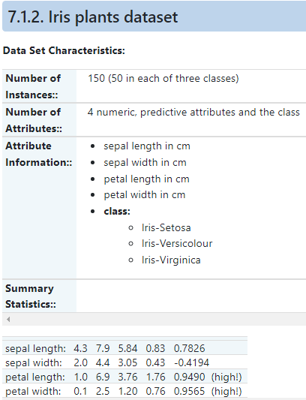
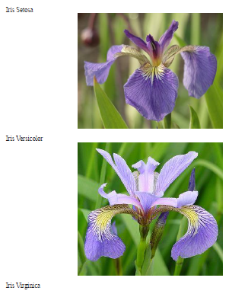
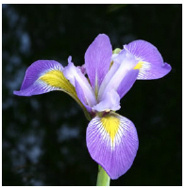

Slide 7
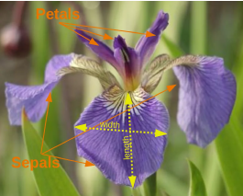
Iris Dataset

Slide 8
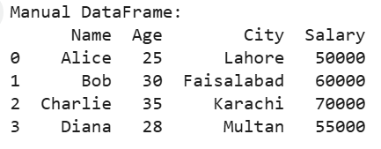
Loading the Dataset
1. Manual Data Creation

Slide 9
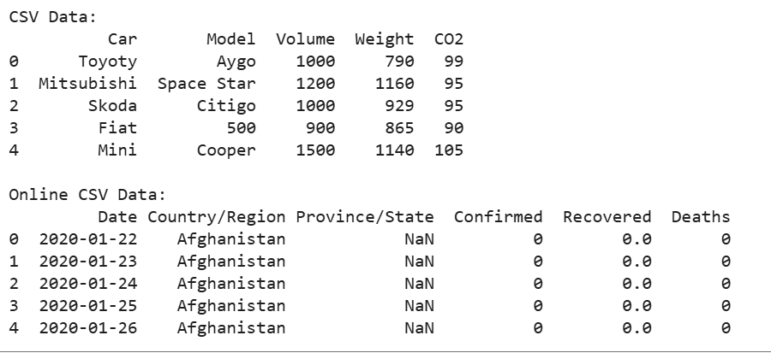
Loading the Dataset
2. Loading from CSV File

Slide 10
Loading the Dataset
Loading from JSON File

Slide 11
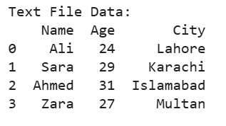
Loading the Dataset
Loading from Excel File
Loading from Text File

Slide 12
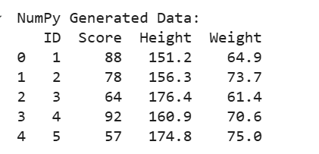
Loading the Dataset
Creating Sample Data with NumPy

Slide 13
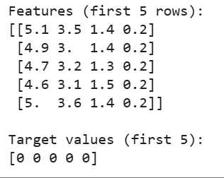
Loading the Dataset
Using Sklearn

Slide 14
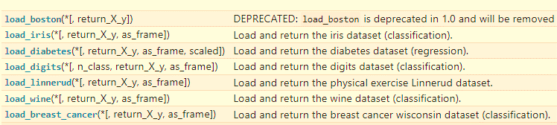
Loading the Dataset
Other data sets

Slide 15
Data Preprocessing
Two major tasks are:
Handling Missing Values
Handling Categorical Values
1. Handling Missing Values
Most ML algorithms cannot work with missing features.
Options for Missing Values:
Remove rows containing missing values.
Remove columns containing missing values.
Fill values with a replacement (e.g., 0, mean, median, mode).

Slide 16
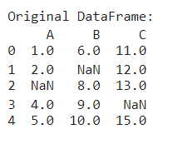
Data Preprocessing

Slide 17
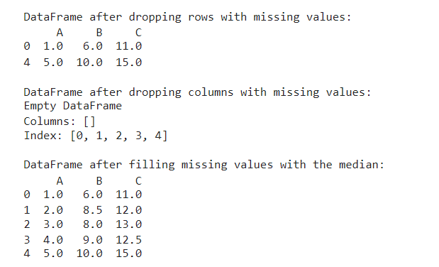
Data Preprocessing

Slide 18
Data Preprocessing
Handling Categorical Values
Most ML algorithms prefer numerical values, not text.
We need to convert categorical attributes into numbers.
Manual Mapping/Ordinal Encoding. (for ordered categories)
Label Encoding (for unordered categories, but a shortcut, usually alphabetically)
One-Hot Encoding (for unordered categories, done properly, create a separate binary (0 or 1) column for each category.

Slide 19
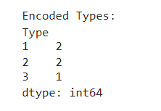
Data Preprocessing

Slide 20
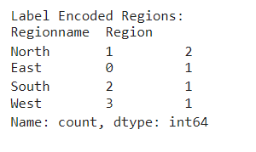
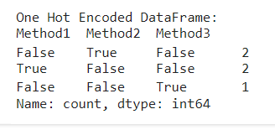
Data Preprocessing

Slide 21
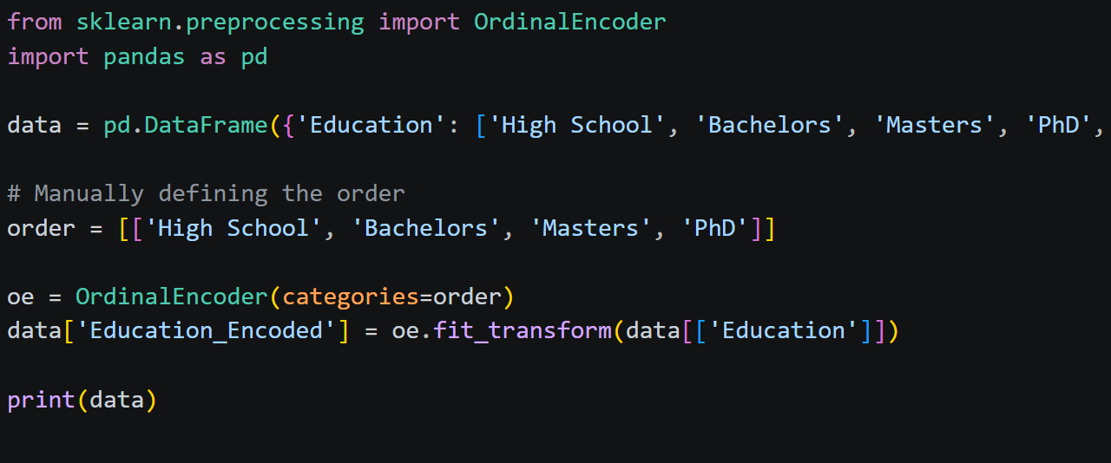
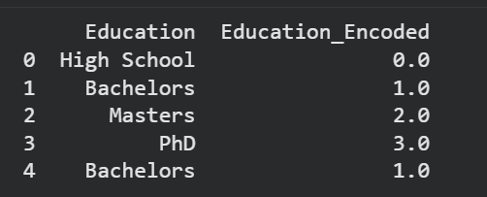
Data Preprocessing

Slide 22
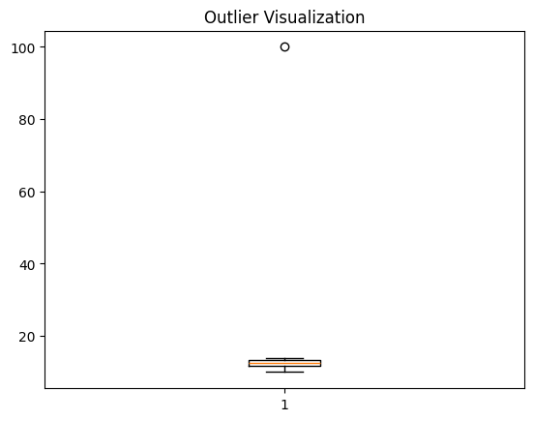
Data Preprocessing
Handling Outliers

Slide 23
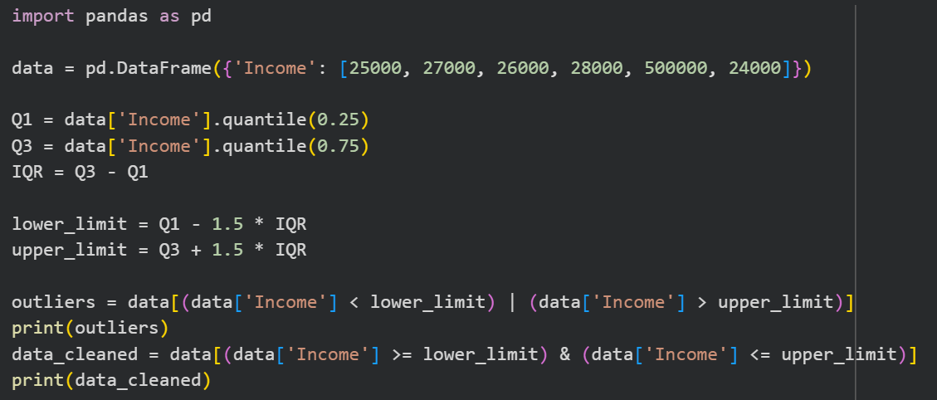
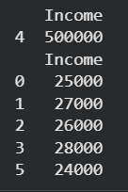
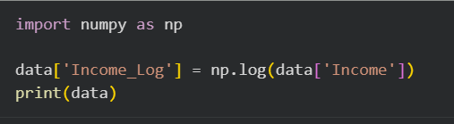
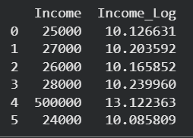
Data Preprocessing
Handling Outliers
Log Transformation

Slide 24
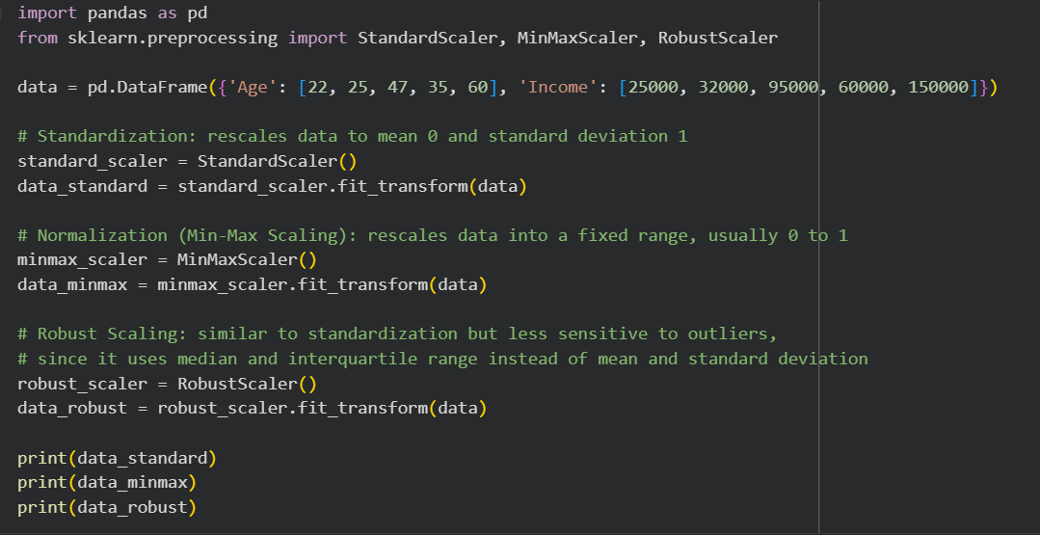
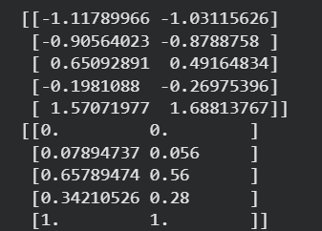
Data Preprocessing
Feature scaling

Slide 25
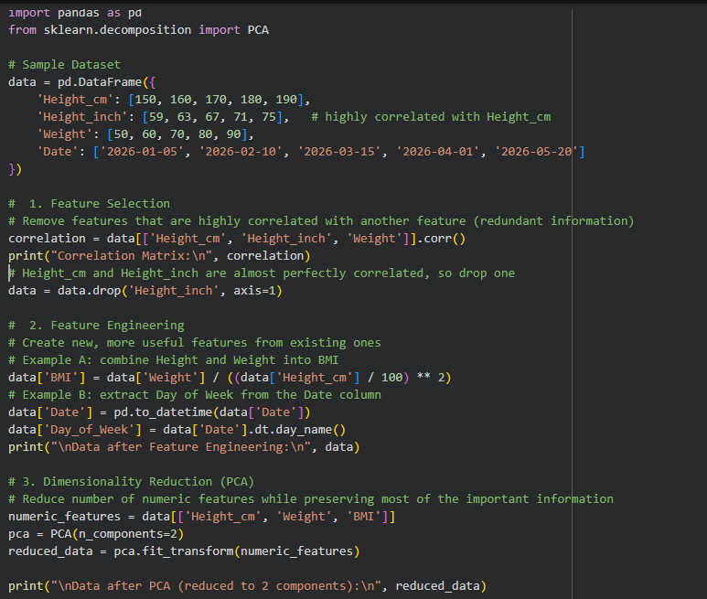
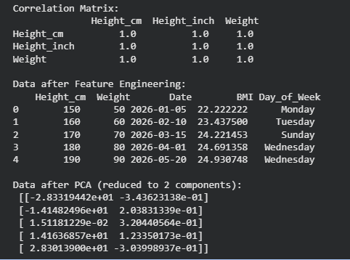
Data Preprocessing
Feature Selection and Feature Engineering Dimensionality Reduction

Slide 26
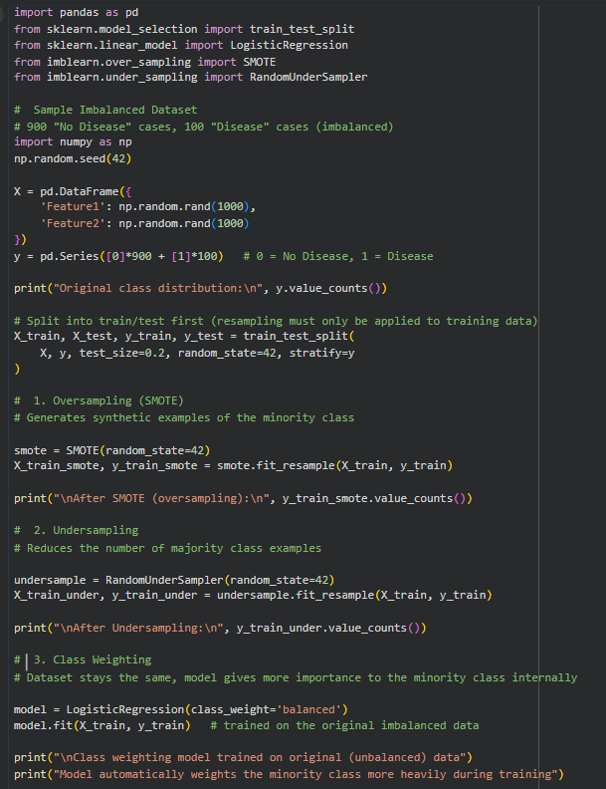
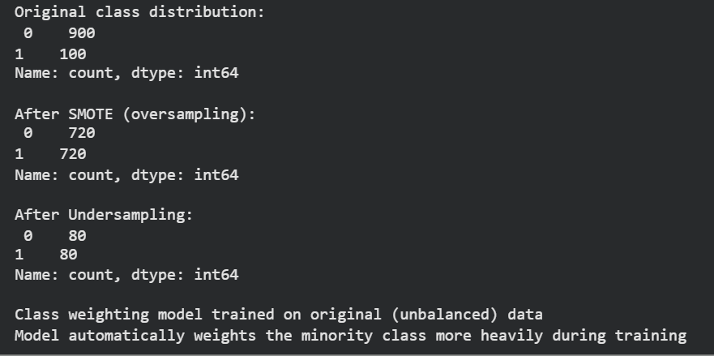
Data Preprocessing
Handling Imbalanced Data

Slide 27
Data Visualization

Slide 28
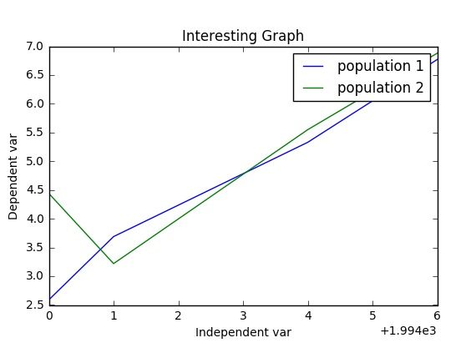
Data Visualization

Slide 29
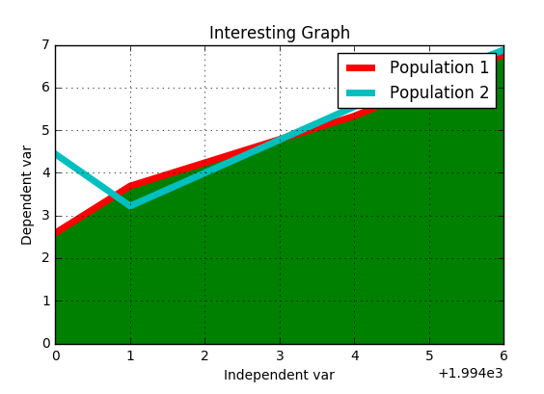
Data Visualization

Slide 30
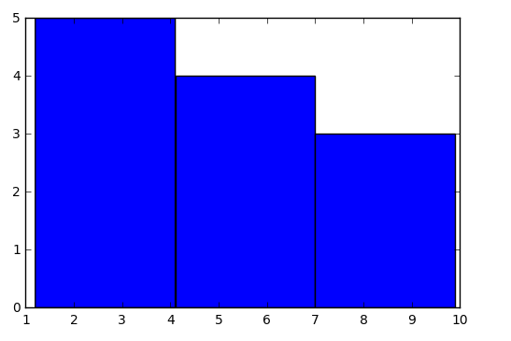
Data Visualization

Slide 31
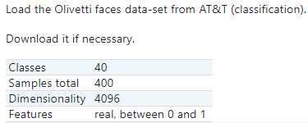
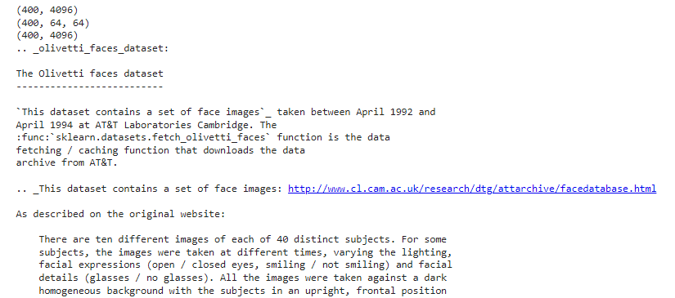
Exploring Data Set

Slide 32
Exploring Data Set

Slide 33
Exploring Data Set

Slide 34
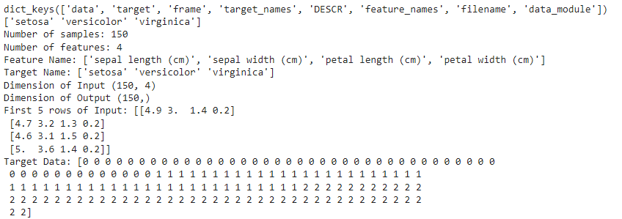
Exploring the Datset
from sklearn.datasets import load_iris
iris = load_iris()
print(iris.keys())
print(iris["target_names"])
n_samples, n_features = iris.data.shape
print('Number of samples:', n_samples)
print('Number of features:', n_features)
print('Feature Name:', iris.feature_names)
print('Target Name:', iris.target_names)
print("Dimension of Input",iris.data.shape)
print("Dimension of Output", iris.target.shape)
print("First 5 rows of Input:",iris.data[1:5])
print("Target Data:",iris.target)

Slide 35
Activity 1
Pakistani Provinces Analysis
Create a dataset of 4 provinces of Pakistan with columns:
Province, Population (millions), Literacy Rate (%), Region (North, South, East, West).
Tasks:
Handle any missing values (drop one row, fill another with median).
Encode the Region column (Label Encoding + One-Hot Encoding).
Visualize population vs literacy rate using a scatter plot (label each province).
Detect if there is any province behaving like an outlier in literacy rate.

Slide 36
Activity 2
Student Performance Tracker
Generate random data for 100 students:
ID, Math, Science, English, Grade (A/B/C).
Tasks:
Handle missing marks (fill with mean).
Encode the categorical Grade column.
Plot a histogram of Math scores with 10 bins.
Identify if any student has an unusually high/low total score using a boxplot.
Summarize findings (e.g., which grade performed best overall).

Slide 37
Activity 3
COVID-19 Dataset Exploration
Load the online dataset:
https://raw.githubusercontent.com/datasets/covid-19/master/data/time-series-19-covid-combined.csv
Tasks:
Extract only Pakistan’s data.
Handle missing values (if any) properly.
Plot a line chart showing cases over time.
Find the day with the highest confirmed cases.
Detect any outliers in daily cases using a boxplot.

Slide 38
Activity 4
Multi-format Data Loading & Visualization Challenge
You are provided with three small files:
students.csv (contains names and marks)
attendance.json (contains student names with attendance %)
extra.xlsx (contains bonus marks per student)
Task:
Load all three files into Pandas DataFrames.
Merge them into a single DataFrame with columns: Name, Marks, Attendance, Bonus.
Create a scatter plot of Marks vs Attendance and highlight students with attendance < 70%.
Apply one-hot encoding on Name.

Slide 39
Activity 5
Data Cleaning & Outlier Detection with Visualization
You are given the dataset below
data = {
"Name": ["Ahsan", "Hira", "Bilal", "Zara", "Salman", "Mahnoor"],
"Age": [25, 27, 35, 29, None, 40],
"Salary": [50000, None, 75000, 2000000, 60000, 90000],
"Department": ["IT", "Finance", "IT", "HR", "Finance", "IT"]
}
Tasks:
Handle missing values properly.
Encode the categorical feature Department.
Detect outliers in the Salary column using boxplot visualization.
Comment on whether Zara’s salary should be treated as an outlier or not.

Slide 40
Activity 6
Explore the dataset the same way the Iris example did in this lab. Print data.keys(), data.target_names, the number of samples and features, data.feature_names, and the shapes of data.data and data.target.
Check for missing values in df. Since this dataset has none by default, artificially introduce some missing values (set 5 random cells in the mean radius column to NaN) and then handle them using an appropriate method (mean or median), justifying your choice.
Check the class distribution of target (malignant vs benign). Report if the dataset is imbalanced, and if so, apply either SMOTE or class weighting, showing the class counts before and after.

Slide 41
Activity 6 (Continue)
Pick any two numeric features (for example mean radius and mean texture) and detect outliers in them using the IQR method, visualized with a boxplot.
Apply log transformation to mean area (a feature likely to be right skewed) and compare its distribution before and after using a histogram.
Apply feature scaling (StandardScaler) to all numeric features, and explain briefly why this step matters before feeding data into distance based models like KNN or SVM.
Reduce the scaled features to 2 components using PCA, then create a scatter plot of the two components colored by target, and comment on whether the two classes appear separable.
Train any two of the following classifiers (SVM, KNN, Random Forest, Naive Bayes) on the scaled data, and compare their accuracy.
In two or three sentences, explain which single preprocessing step (scaling, outlier handling, PCA, or imbalance correction) you think had the biggest impact on this dataset, and why.

